Slide 1
Cyclist Bike – Share Analysis
Analysed by Balachander.S

Slide 2
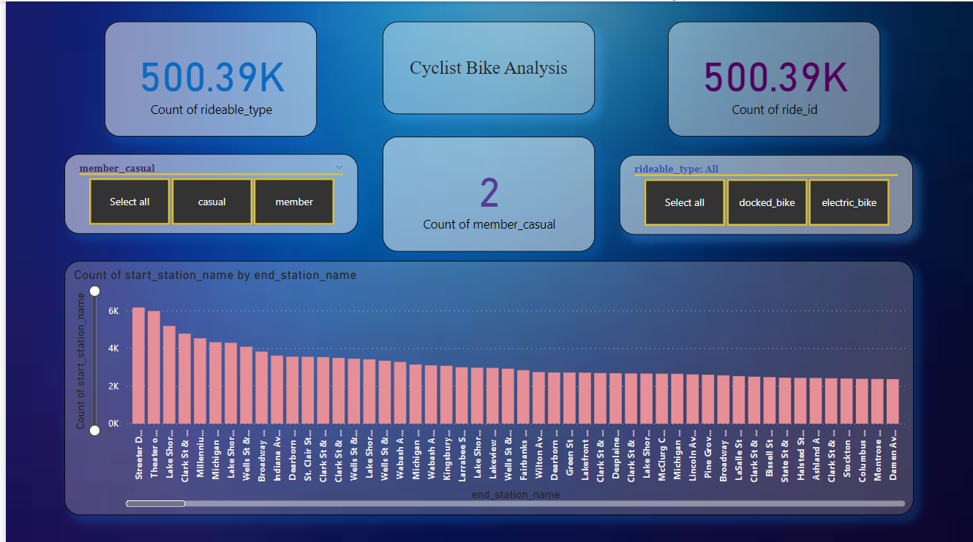

Slide 3
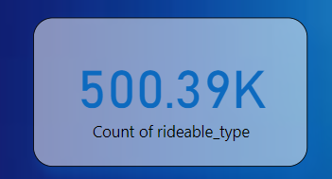
Count of rideable_type:
The card represents Count of rideable_type

Slide 4
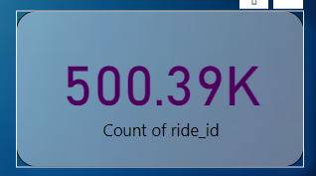
Count of ride_id:
The card represents the Count of ride_id

Slide 5
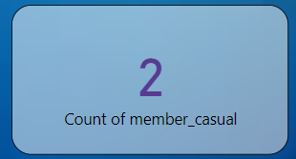
Card:
The card represents the count of member

Slide 6
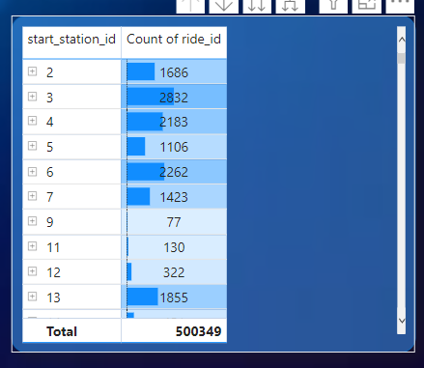
Matrix Table:
The table represents the data for start_station_id and count of ride_id

Slide 7
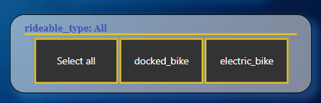
Slicer:
Slicer is used to for docked_bike and electric_bike.
Tile is selected for the view.

Slide 8
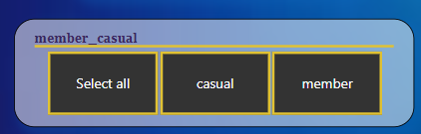
Slicer:
Slicer is used for category of casual and member

Slide 9
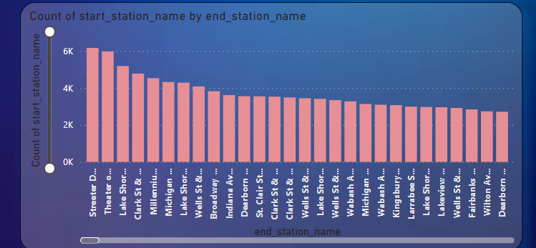
Bar chart:
Bar chart shows the count of start_station_name and end_station_time.
The chart shows the usage of station.

